Slide 1
16-Bit Multi-Cycle General purpose RISC Architecture
BY
BASATI SIVAKRISHNA(22976)
KATTA JOHN AKHIL(23021)

Slide 2
OBJECTIVES
Disadvantage of single-cycle RISC: Inefficiency due to fixed instruction execution time, leading to wasted clock cycles for simpler instructions.
Advantage of multi-cycle RISC: Improved performance and resource utilization by allowing instructions to take varying numbers of cycles based on complexity, enhancing overall throughput.
The designed processor is flexible to do pipelining by simply manipulating the minimum no.of variables.

Slide 3
SPECIFICATIONS
Implemented using Von Neumann architecture where data and instructions share the same memory and bus, allowing for sequential execution of instructions.
16-bit RISC processor. Which does fetch, decode, execution, and write stages sequentially in multiple cycles.
8 General purpose 16-bit Registers(R0-R7).
16-bit program counter and Instruction Register.
It supports 11 Arithmetic and Logical Instructions.

Slide 4
SPECIFICATIONS
It supports 4 conditional branch instructions to support loops.
It supports Load and Store instructions with PC relative addressing (5-bit signed relative address).
16-bit Arithmetic and logic unit (ALU).
Instruction memory
o Instruction size – 16 bits
o Address width – 16 bits
Data memory
o Data width – 16 bits
o Address width – 16 bits.

Slide 5
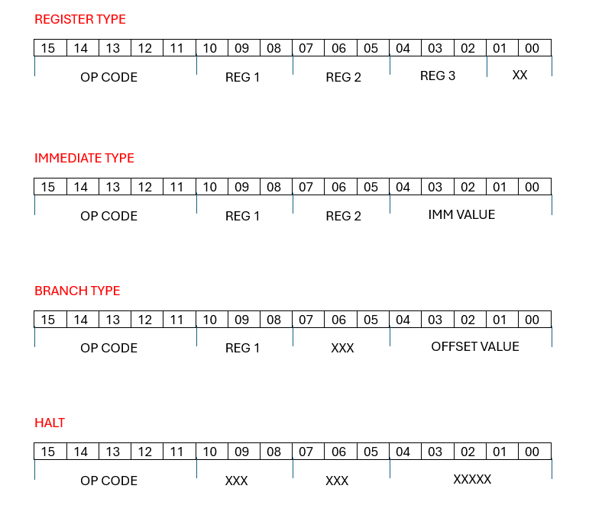
INSTRUCTION SET ARCHITECTURE:
ADDRESSING MODES:
REGISTER TYPE:
ADD,SUB,MUL,AND,OR,INV,LSL,LSR,DEC, INC,MOV,SLT.
IMMEDIATE TYPE:
MOVI,ADDI,SUBI,SLTI.
BRANCH TYPE:
BNEQ,BEQ,BEQZ,BNEQZ,LD,ST.
HALT TYPE:
HALT

Slide 6
ARCHITECTURE:
1
=0
COND
+
NPC
REGISTER BANK
A
IE
A
L
U
O
U
T
INSTRUCTION AND DATA MEMORY
M
A
L
U
ID
U
PC
IF
IR
X
B
M
U
X
M
I
M
M
U
SIGN
EXTEND
X
WB

Slide 7
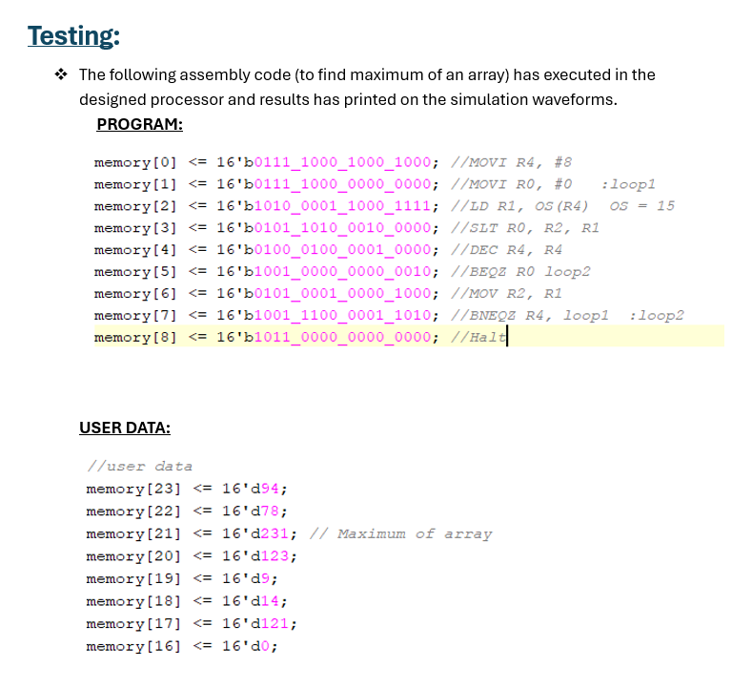

Slide 8
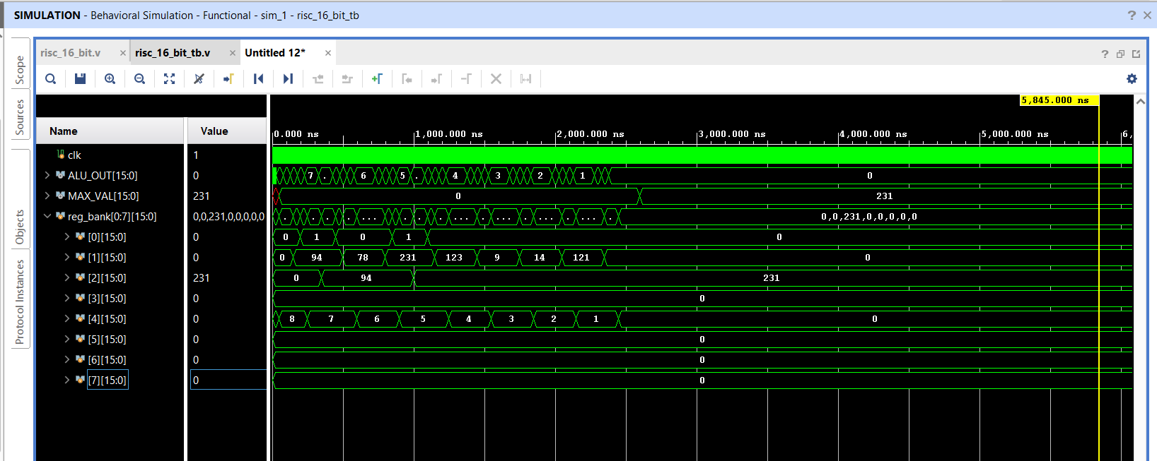
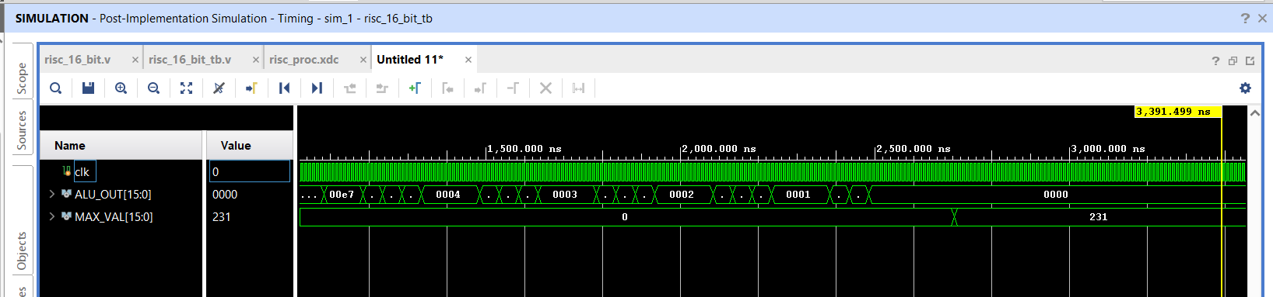
RESULTS:
BEHAVIOURAL SIMULATION:
POST SIMULATION:

Slide 9
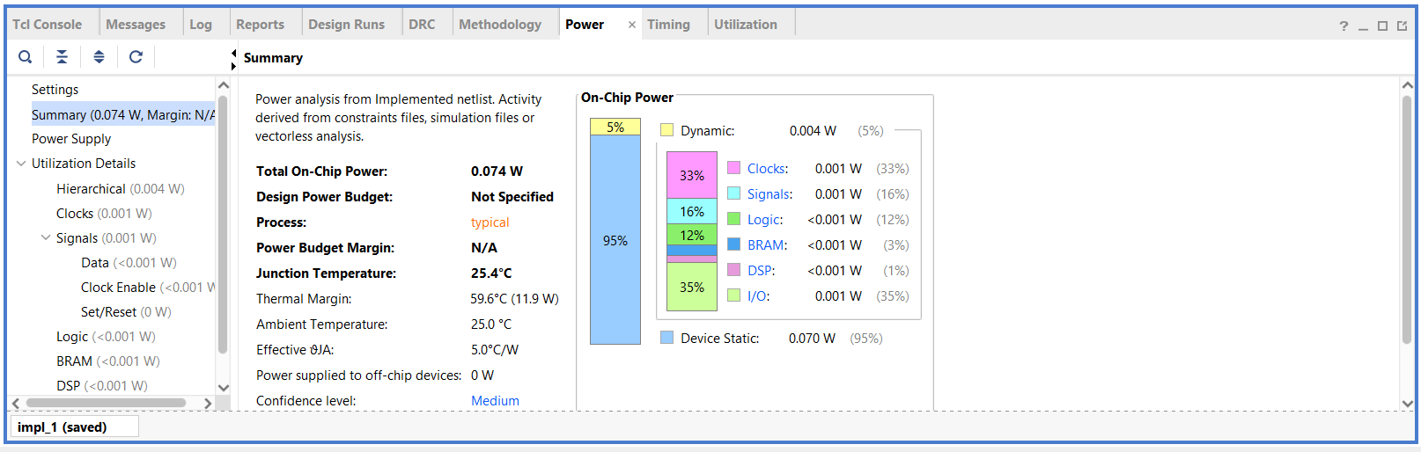
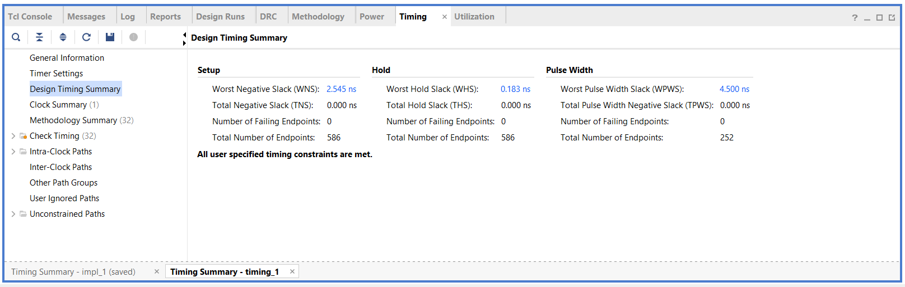
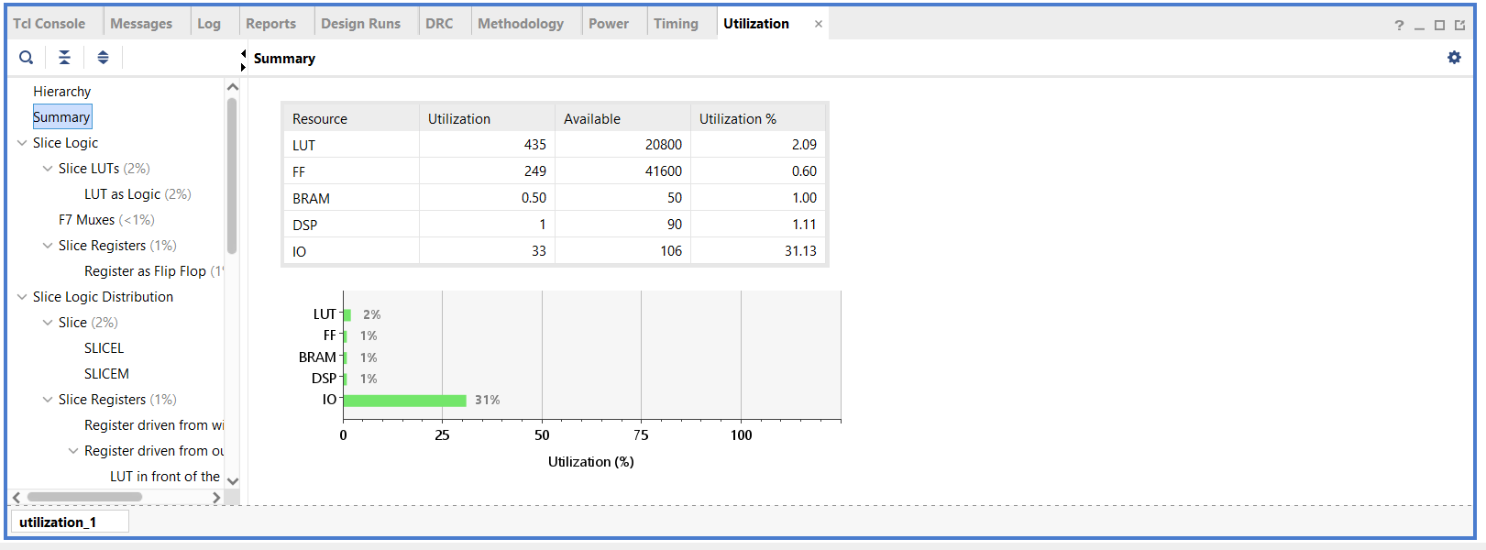
REPORTS:

